Slide 1

Machine Learning DDoS Detection
Zekun Li
Supervised by Prof. Miguel Garzón

Slide 2
Intro & Background
What is DDoS?
- Distributed denial-of-service attack
- Attack aim to suspend or reduce the internet servicing capability of a machine or a network.
How DDoS work?
- Flood the victim with massive junk data from zombie network.
- Malicious use of protocol (e.g. SYN flood, HTTP flood)
- Asymmetric amplified attack from innocent third party server. (e.g. DNS Amplification Attack)
Why work on DDoS?
- Very common and tricky to handle.
- Service suspended -> Unhappy clients -> Losing customers ->Losing $$$

Slide 3
Overview
Dataset
Preprocess
Generate Features
Training
Result

Slide 4
Dataset
CICDDoS2019, CICIDS2017
From UNB, Canadian Institute for Cybersecurity
DARPA_2009_malware-DDoS_attack-20091104
From USC/ISI ANT
Mirai-B-scanning-20160601
From USC/ISI ANT

Slide 5
Dataset
CICDDoS2019
Include 12 types of attack:
DNS, LDAP, MSSQL, NetBIOS, NTP, Port Map, SNMP, SSDP, SYN, TFTP, UDP, UDP-Lag
Over 60 million flows
Total size of 27.8G
CICIDS2017
Benign data
10G of packets

Slide 6
Overview
Dataset
Preprocess
Generate Features
Training
Result

Slide 7
Preprocess
Tool: CICFlowMeter (formerly ISCXFlowMeter)
Analysis .pcap packet capture file
Generate bidirectional flows data with more than 80 statistical network traffic features
E.g. Duration, Number of packets, Number of bytes, Length of packets, etc.
Export into a CSV file

Slide 8
Preprocess
CICFlowMeter
Refine
Raw Data
.pcap
Flow Data
.CSV
Input Data
DataFrame
Source
Destination
Protocol
Length
Source IP
Destination IP
Flow Duration
Forward Packets
( Total 87 features)
Source IP
Destination IP
Flow Duration
Forward Packets
( Total 25 features)

Slide 9
Overview
Dataset
Preprocess
Generate Features
Training
Result

Slide 10
Generate Features
Features are generated for each window
A window is a set of flows from input data , divided by:
Time Based: For each flow, the flow within n seconds before it.
Connection Based: For each flow, the flow within n flows before it .
As the flow is bidirectional, the features are generated accordingly with forwarding and backward direction.

Slide 11
Generate Features
Features including the following aspects:
Total flows in the window
Total size of the flow
Mean, max, min, standard deviation of the size
Interval between each flow
Total bytes used in header
Number of flows with X flag:
X is FIN, RST, SYN, PUSH, ACK, URG, CWE, ECE

Slide 12
Generate Features
Input Data
DataFrame
Feature Data
DataFrame
Total flows forward
Total flows backward
Flow Interval
Number of flows with X flag
( Total 28 features)
Source IP
Destination IP
Flow Duration
Forward Packets
( Total 25 features)

Slide 13
Overview
Dataset
Preprocess
Generate Features
Training
Result

Slide 14
Training
Use Feature Data as input
Use a Boolean value to represent if the window is from malicious flow data
Data split
Benign Data : Malicious Data = 2 : 1
Train set : Test set = 0.8 : 0.2

Slide 15
Training
Training Method:
K-nearest neighbors
Multilayer Perceptron
Random Forest
Naive Bayes
Multinomial Naive Bayes
Bernoulli Naive Bayes

Slide 16
Overview
Dataset
Preprocess
Generate Features
Training
Result

Slide 17
Work flow
Demonstration using following data:
Malicious
Source: CICDDoS2019
Attack type: SYN Flood
Size: 100K Flows
Benign
Source: CICDDoS2017
Size: 200K Flows

Slide 18
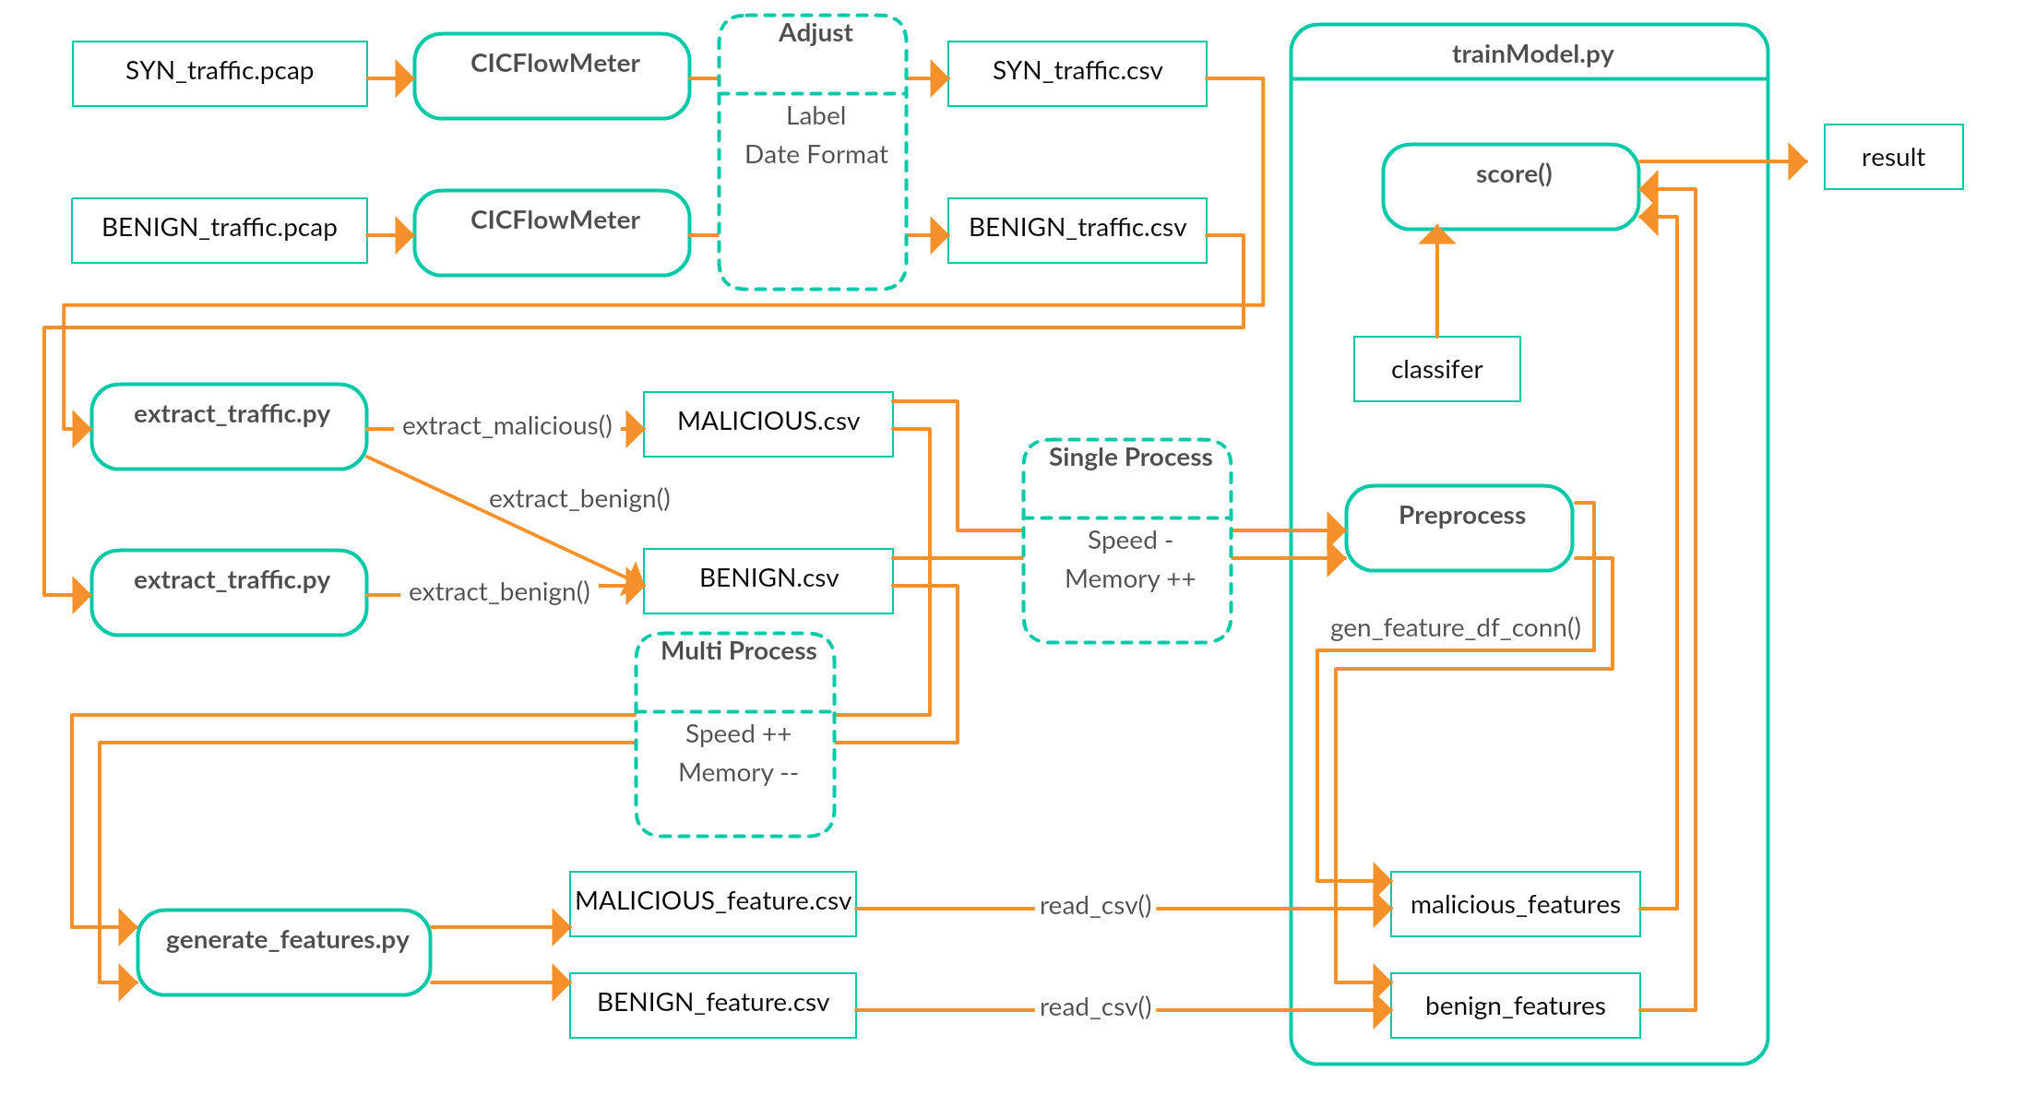
Work flow

Slide 19
Result
Connection based window size = 20
cross-validation splitting = 10

Slide 20
Analysis of the previous result
The accuracy, recall and precision score are too high, not in line with common sense.
As cross-validation is set to 10, it’s unlikely there is an overfitting
Most likely because of the nature of SYN flood attack
By checking the generated features, for each window in malicious flows, more than 95% of the flow is outbound and contains a ACK flag
In benign data, the flow with ACK flag is less than 40%
So, we can say the result is reliable and achievable under the feature generation method in this project.

Slide 21
References & Related work
A Deep Learning Based DDoS Detection System in Software-Defined Networking
A deep learning based intelligent framework to mitigate DDoS attack in fog environment
DDoS Attack Detection based on Chaos Theory and Artificial Neural Network
DDOS DETECTION AND MITIGATION USING MACHINE LEARNING
DDoS Detection Using Artificial Neural Network Regarding Variation of Training Function
Detecting Distributed Denial of Service Attacks Using Data Mining Technique
Detection and Analysis of DDoS Attacks Using Machine Learning Techniques A Literature Review
Detection of DDOS Attacks in Network Traffic Using Deep Learning
Detection of Distributed Denial of Service Attacks Using Artificial Neural Networks
Machine-learning and Statistical Methods for DDoS Attack Detection and Defense System in Software Defined Networks
Machine Learning DDoS Detection for Consumer Internet of Things Devices
Machine Learning Based DDoS Attack Detection From Source Side in Cloud camera ready

Slide 22
Thank you

